Slide 1
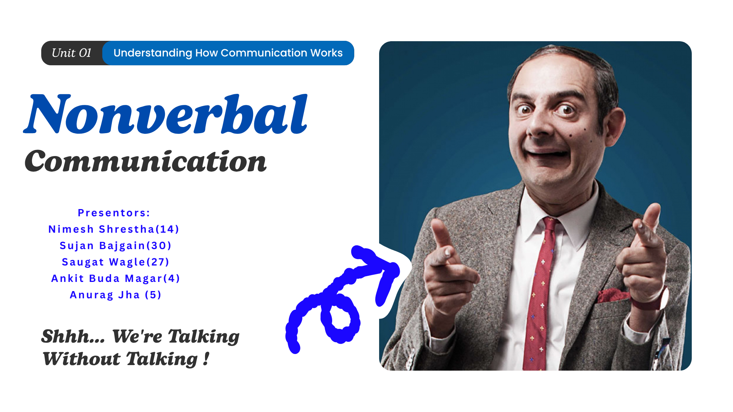

Slide 2
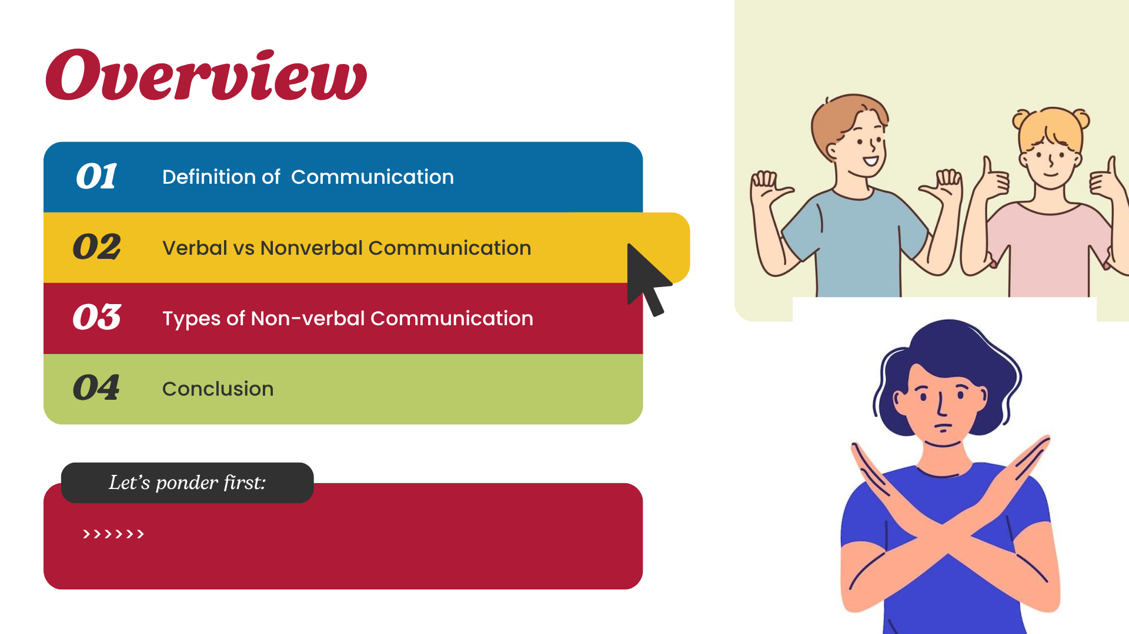

Slide 3
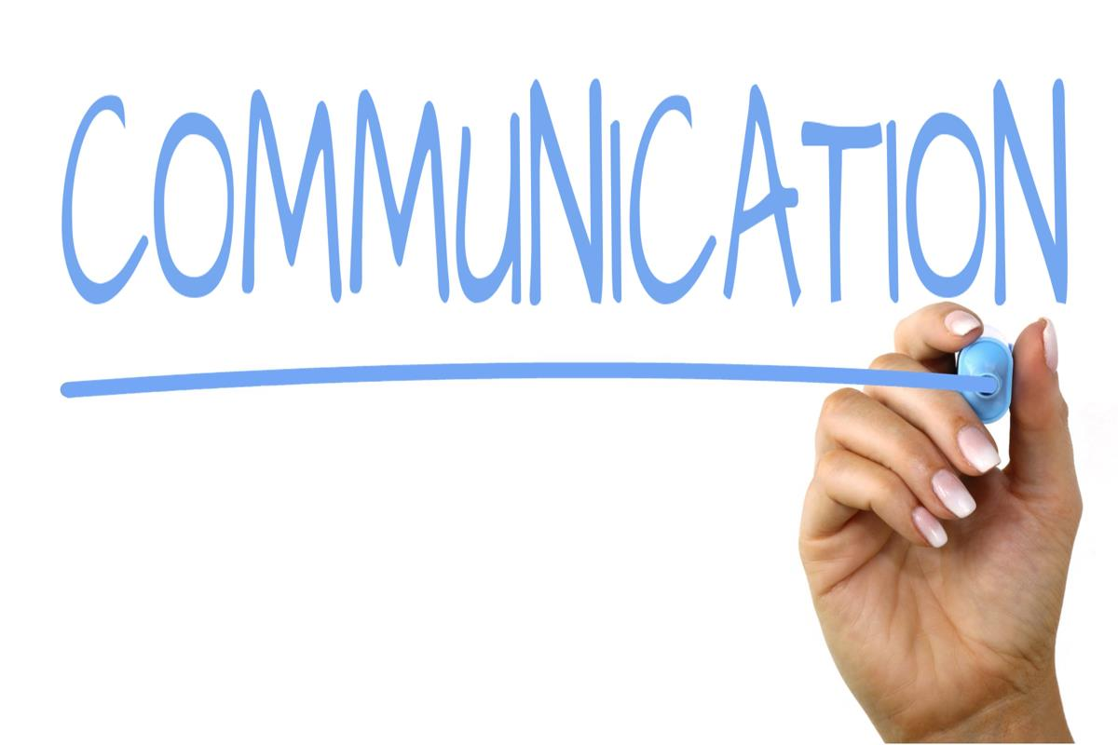

Slide 4
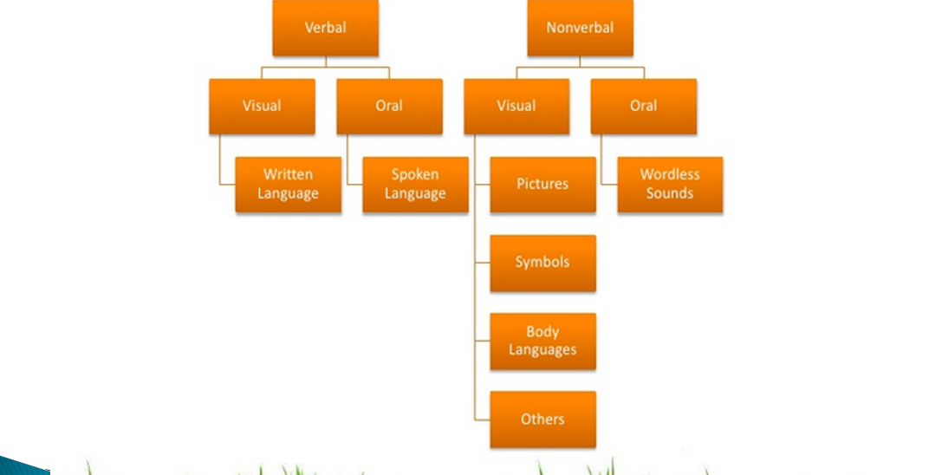

Slide 5
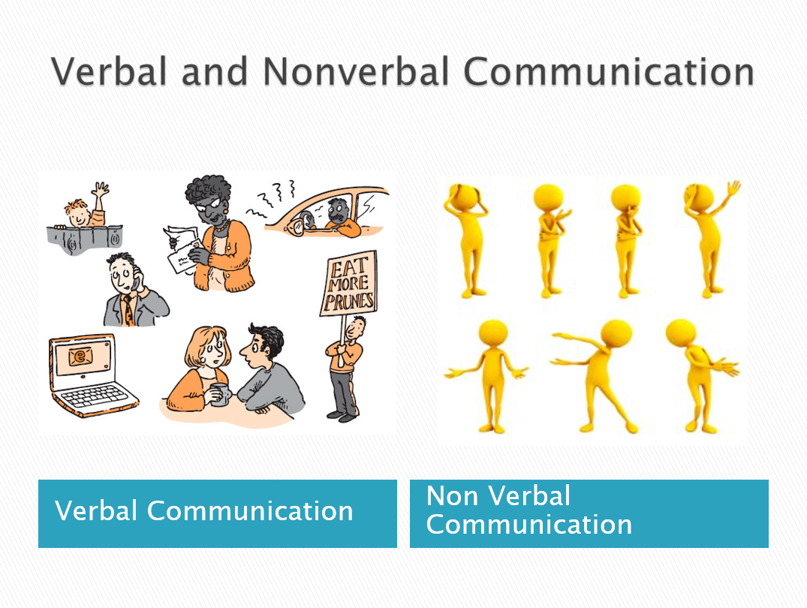

Slide 6
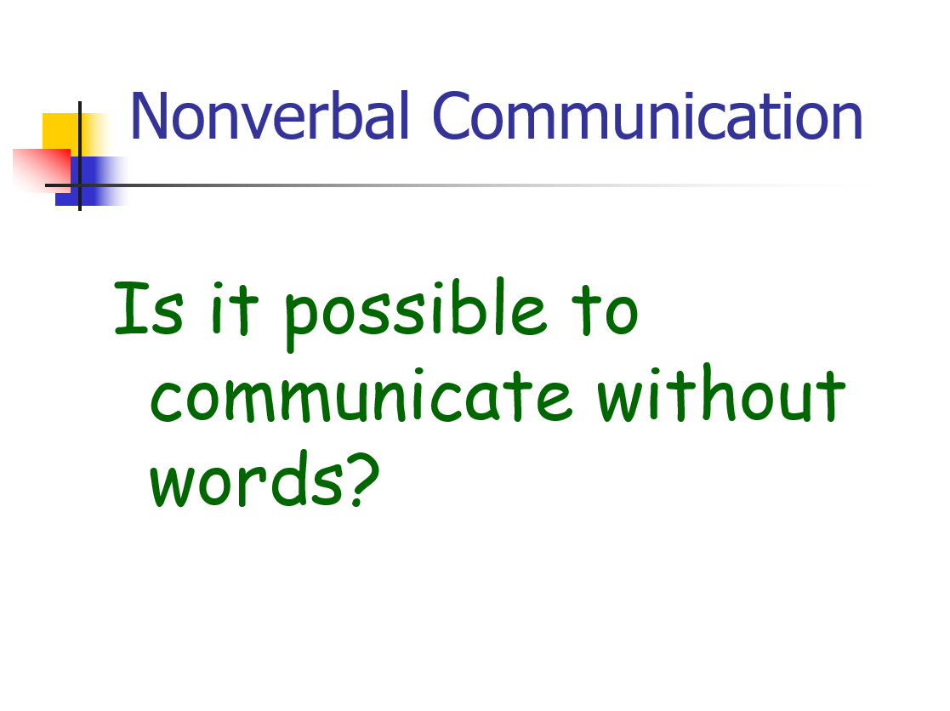

Slide 7
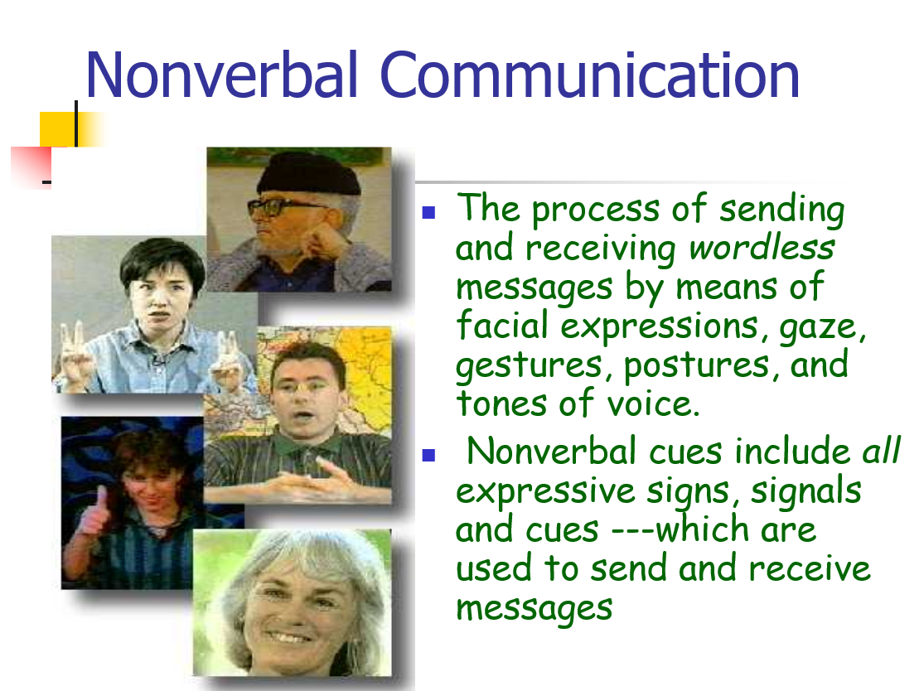

Slide 8
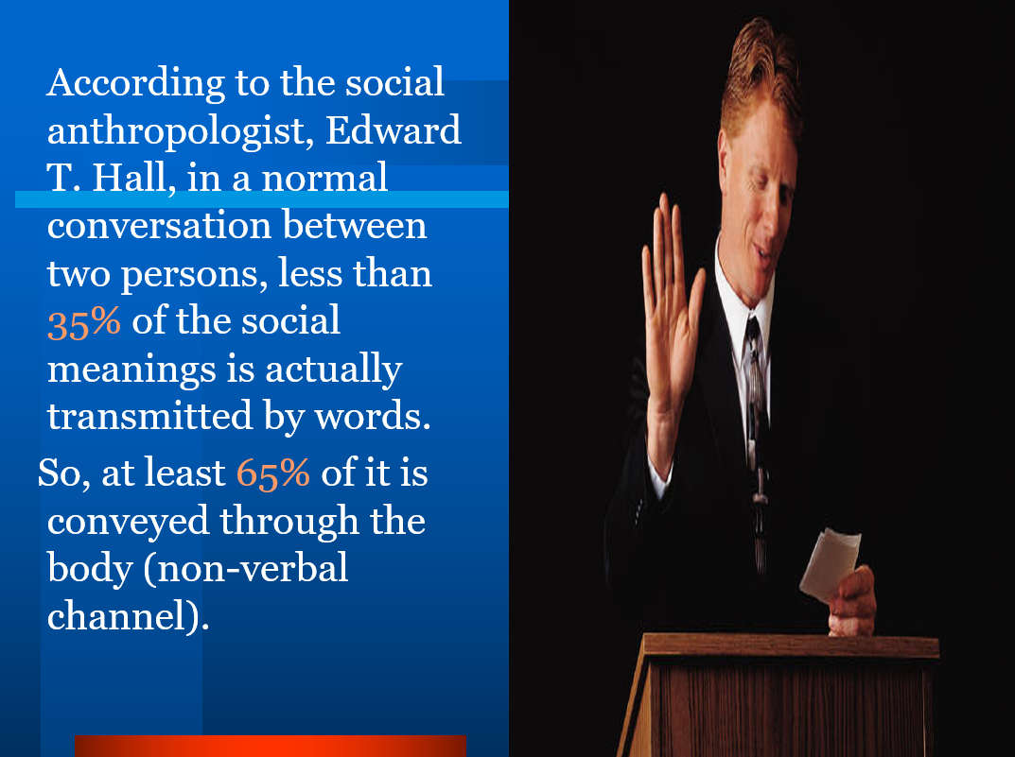

Slide 9
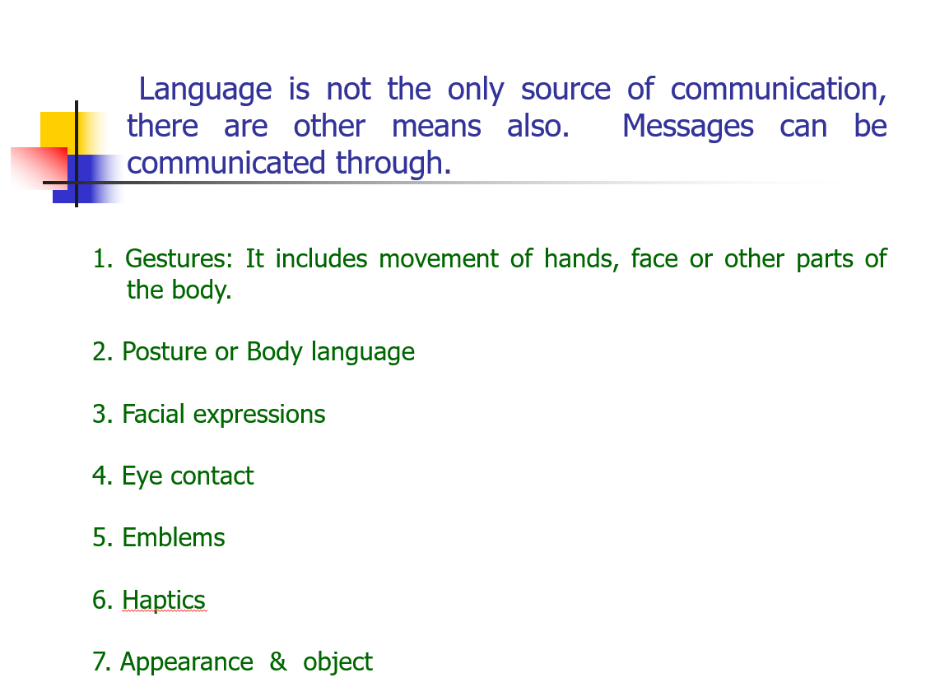

Slide 10
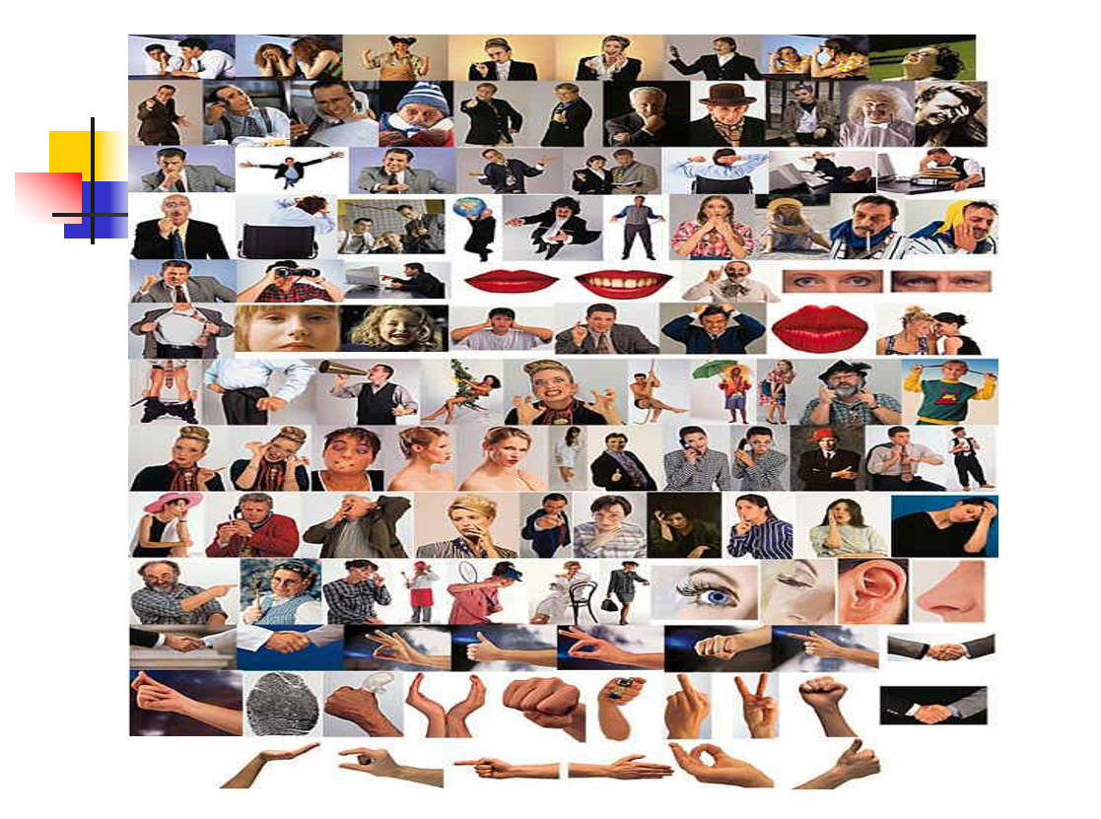

Slide 11
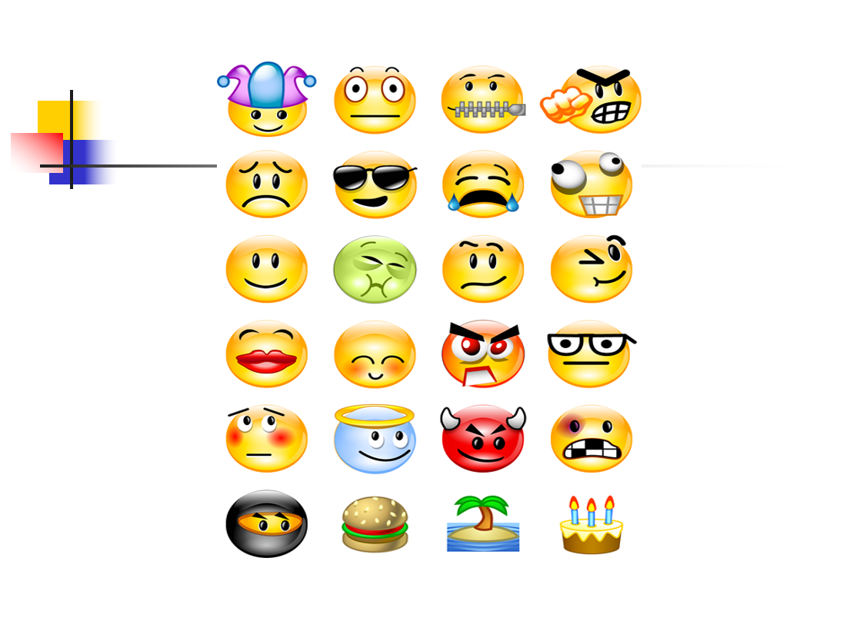

Slide 12
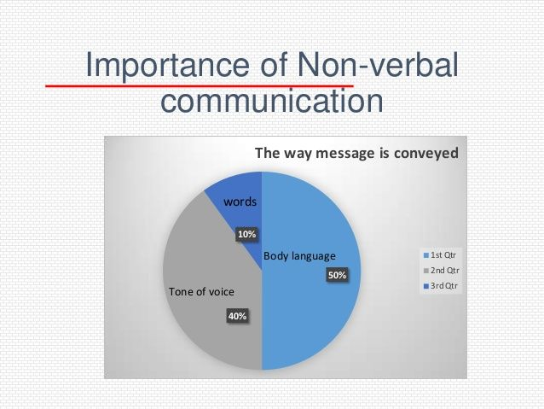

Slide 13
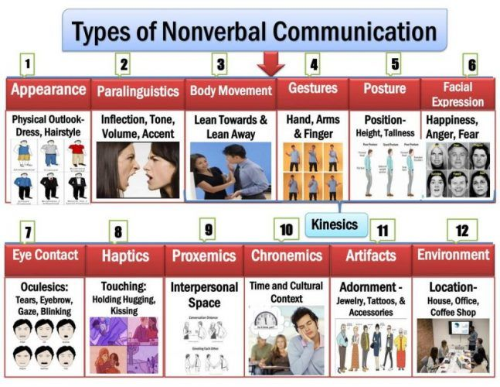

Slide 14
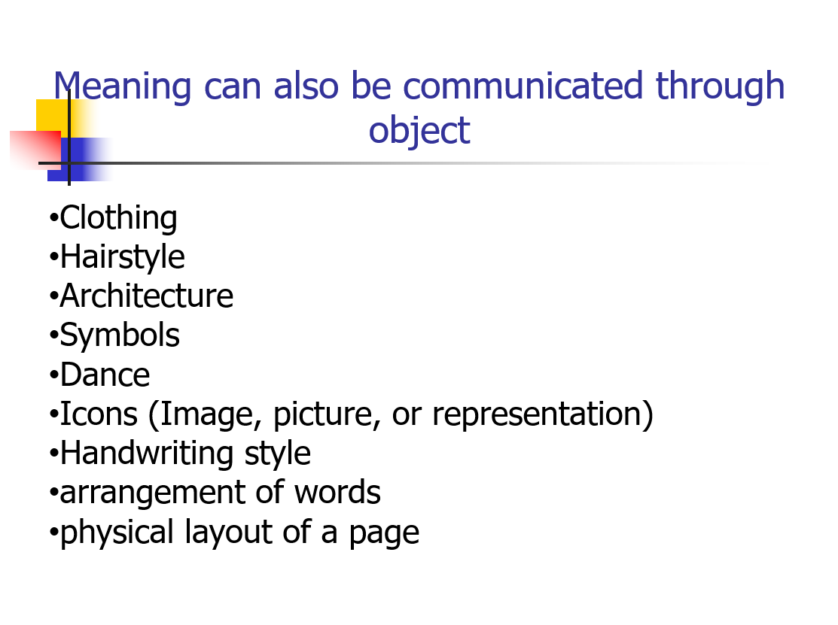
Body Appearance

Slide 15



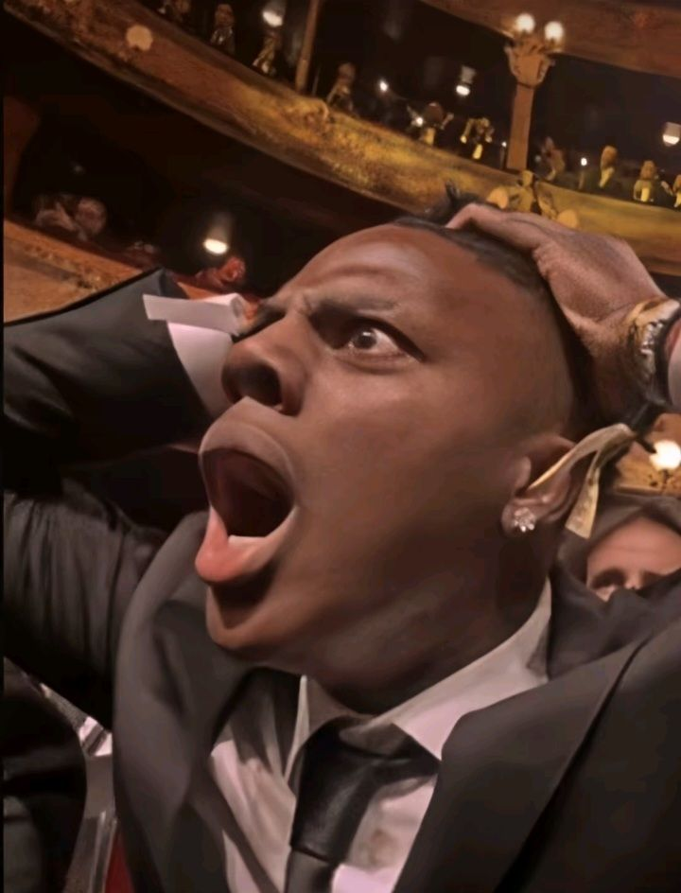
Facial Expression
*These usually convey emotion.
*There are six universal emotions.
Surprise
Fear
Sadness
Anger
Happiness
Disgust

Slide 16
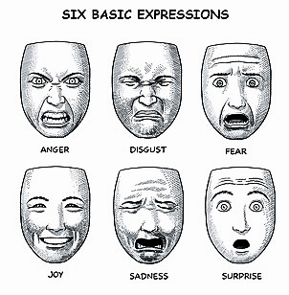

Slide 17
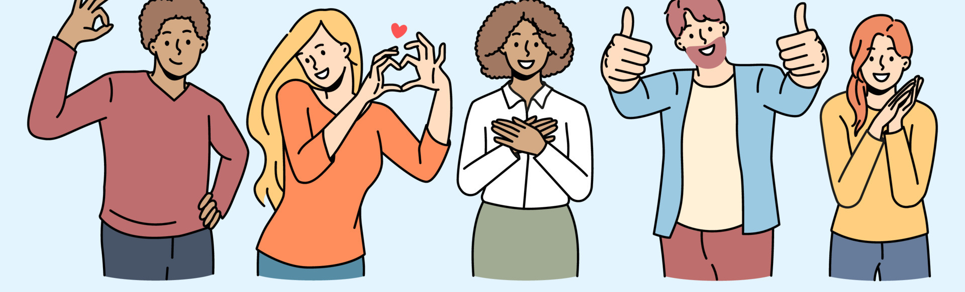
Kinesics
-It is the study of body’s physical movement.
-It include personal appearance, facial expression, eye contact, posture, gesture, body movement.
-Eg: nodding our head, blinking our eyes, waving our hands, shrugging our shoulders.

Slide 18
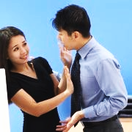
Proxemics
Proxemics is the study of how we communicate with the space around us.
Non-verbal communication includes not only body language but also space, time, physical environment around us.
It is a study of how we arrange space and what we arrange in it.

Slide 19
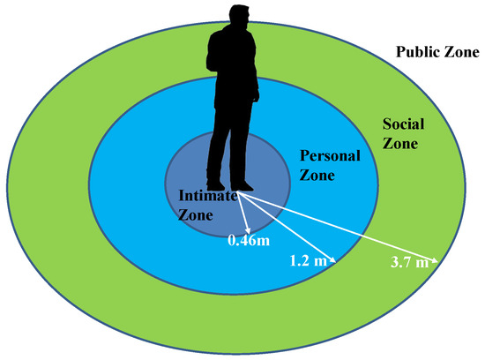
Intimate space : -It is extend from personal touch to one and half feet. -Eg: Family members, spouse, close friends…
Personal - 18 inches to 4 feet. - Eg: colleagues, peers, relatives…
Social space: - 4 to 12 feet
- Eg: official space, business environment…
Public space: - 12 feet to range of hearing and seeing.
- Eg: formal or things insignificant for you…

Slide 20

Paralanguage
The way in which we say the word. -
Para means ‘like’. Like language
- It tells about the gender, background, education.
- It involve voice quality, volume, pace, pitch, pronunciation and pause.
It refers to those nonverbal characteristics associated with the production of words through speech.

Slide 21


Chronemics:
Chronemics is the study of how time affects communication.
Chronemics looks at how the use of time communicates messages — like:
Being early = showing respect or enthusiasm
Being late = possibly rude, or dominant (in some cultures)
Making someone wait = a subtle power move
Fast talking = excited, anxious, or persuasive
Pauses/silence = dramatic effect, discomfort, or emphasis

Slide 22
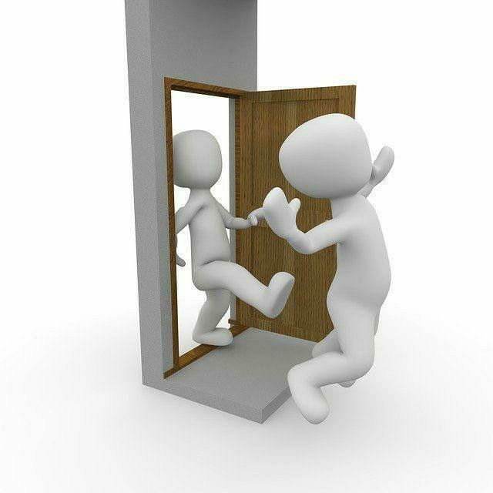

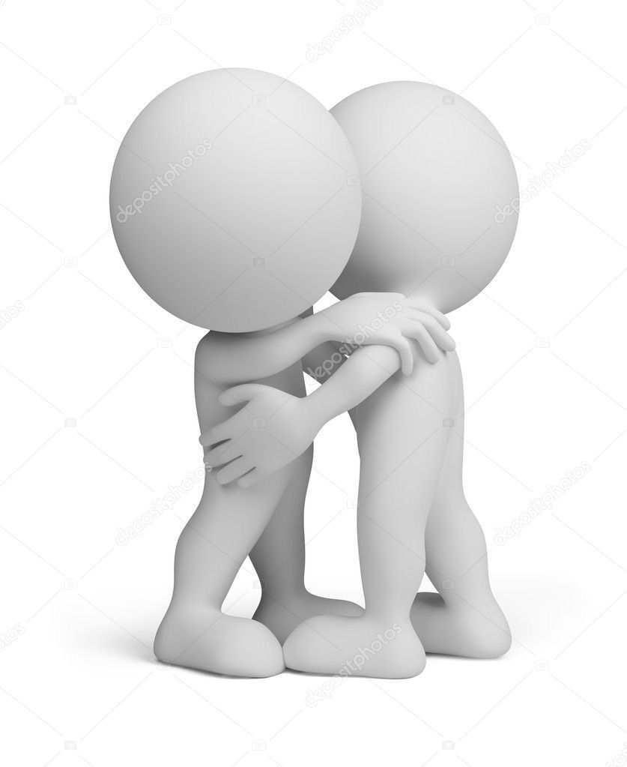


Haptic
Haptic means touching behaviours.
Examples of Haptic Communication:
🤝 Handshake – greeting, confidence, agreement
🤗 Hug – affection, comfort, sympathy
✋ High five – celebration, encouragement
👋 Pat on the back – praise, motivation
👆 Tap on the shoulder – getting attention
😬 Slap – anger, warning (not recommended 😅)

Slide 23
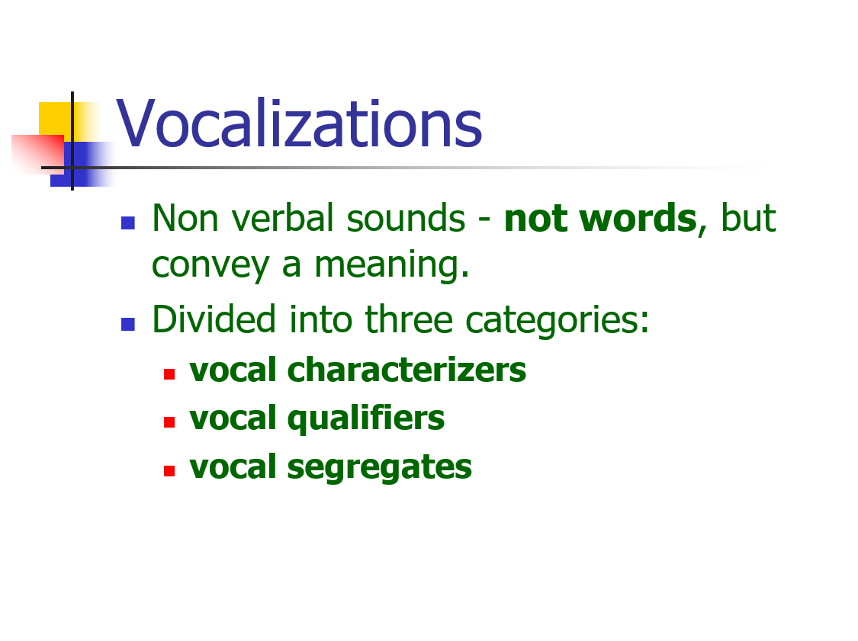

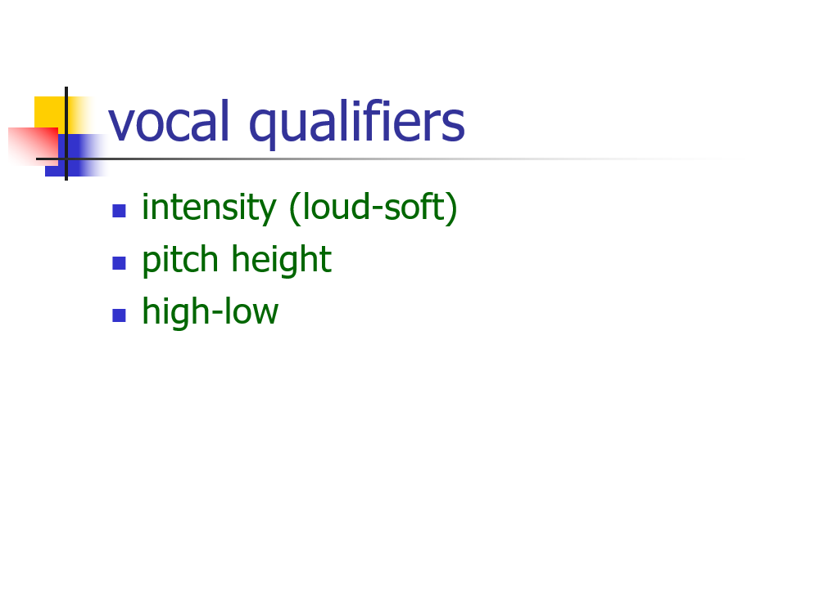
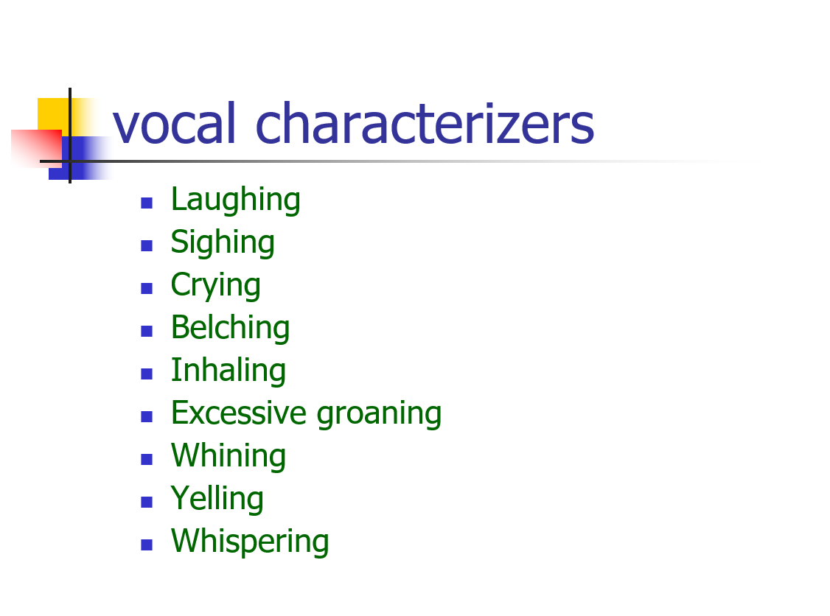

Slide 24
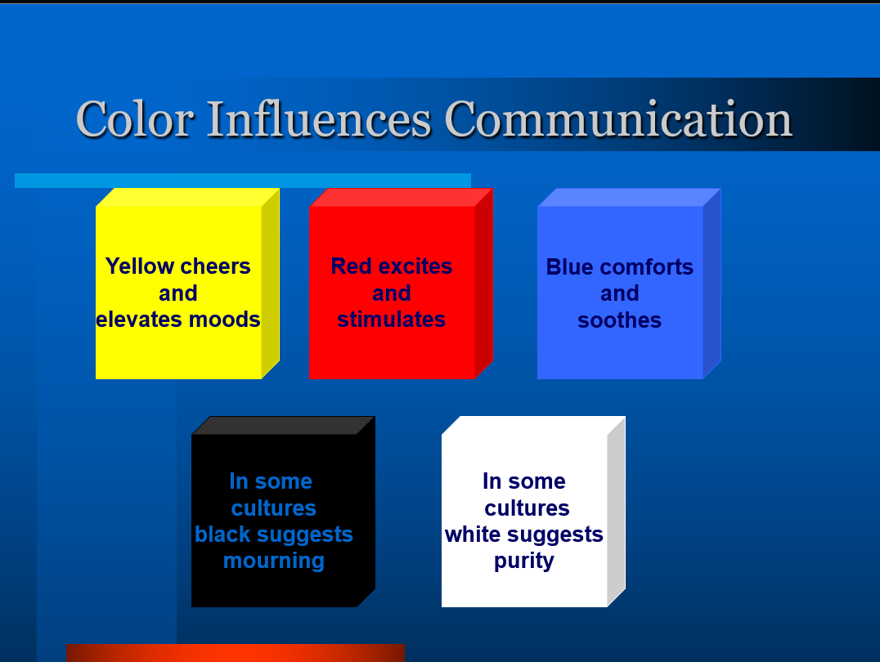

Slide 25
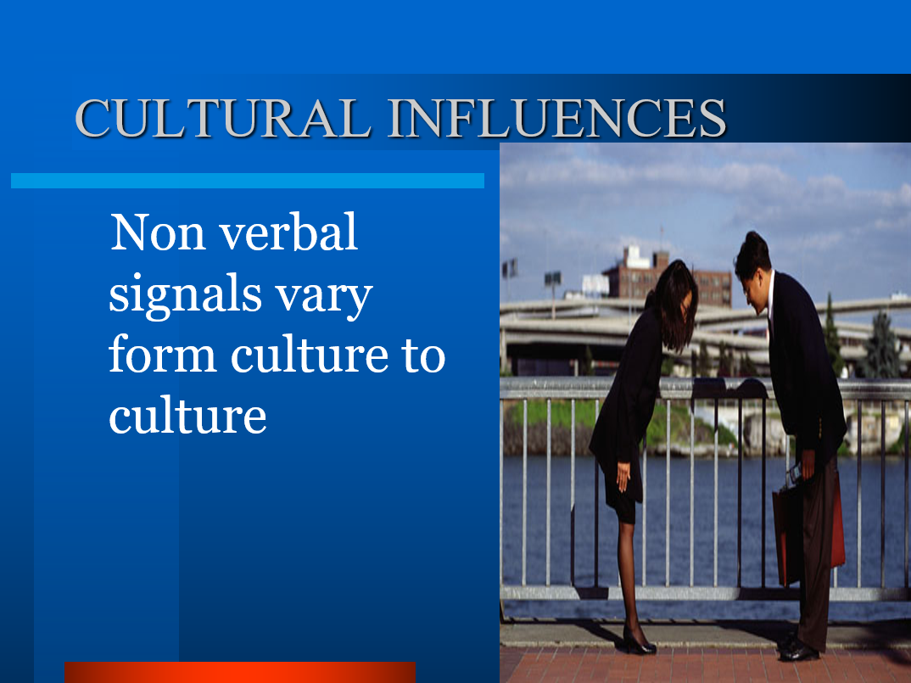

Slide 26
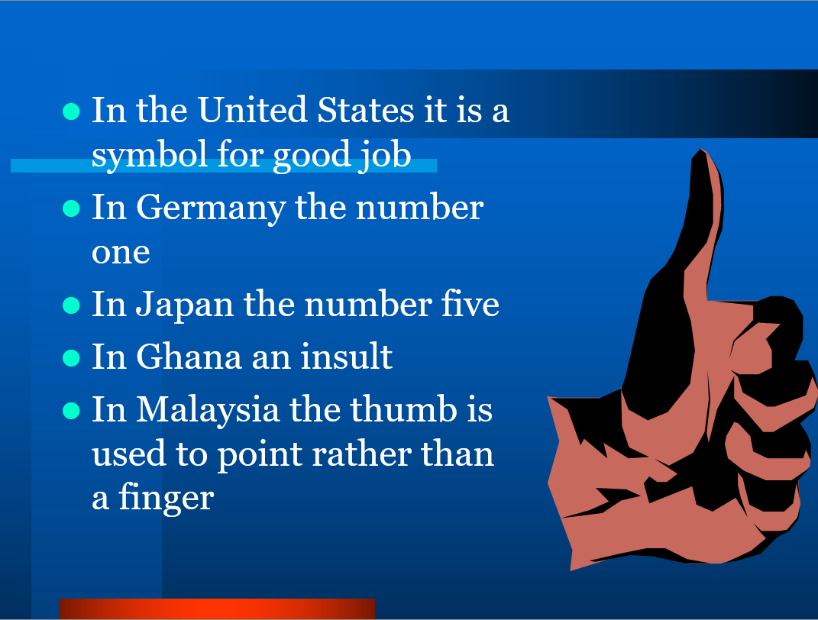

Slide 27
Conclusion
1. While communicating: Make appropriate eye contact. Tone down the facial expression. Make the right impression with your body movement.
2. Non-verbal communication is an important part of human interaction. Our body language produces emotional leakages and allows other people to read us.
3. As you continue to pay attention to the non-verbal cues and signals you send and receive, your ability to communicate will improve.
4. Sometimes it may create misunderstanding so be careful.

Slide 28





References

Slide 29


